Slide 1



Lean Six Sigma Yellow Belt Experience
Project Template
Dr. Marcelo Machado Fernandes
Lean Six Sigma Master Black Belt
ASQ MBB | Minitab CTP

Slide 2

Prof. Marcelo M. Fernandes
Marcelo is an enthusiastic global expert in operational excellence and a learning strategy innovator. He has developed an unique teaching style (virtual, in-person and blended) to present Lean Six Sigma concepts using gamification and other active learning methodologies.
In his 20 years of experience he has designed and deployed global continuous improvement strategies/programs in different companies, reaching significant positive results like 20x ROI and zero defect for critical processes.
He is one of the few (around 130 in the world - as of 2022) active ASQ Certified Master Black Belts and the main author of the cover story of "Quality Progress" journal (Feb 2019).
Marcelo is an official Minitab training provider in Brazil.
He holds a PhD and a Master's Degree in Industrial Engineering with research focused in Operational Excellence - Lean Six Sigma. He has trained more than 100,000 people from more than 100 different countries and mentored/coached more than 500 improvement projects (industry and service).
He has solid careers in both academic and corporate worlds and is a firm believer that passion is the main ingredient to change processes for the better and that simplicity is powerful.

Slide 3
Education is not the filling of a pail, but the lighting of a fire.
(William Butler Yeats)

Slide 4
What this class is
A virtual training experience
A yellow belt certification process
A hands on experience with Minitab
A set of organized recorded classes
What this class is not
Coaching
Consultancy
Dr. Marcelo Machado Fernandes - MF Operational Excellence ©

Slide 5
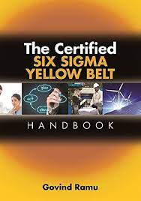

An important reference

Slide 6
The DMAIC Roadmap
Define
Analyze
Control
1
3
5
2
4
Measure
Improve

Slide 7
DMAIC Roadmap
DEFINE
1 – Listen to the VoC
2 – Create Project Charter
3 – Map Current Process
MEASURE
4 – Investigate Measurement Systems
5 – Run Control Chart
6 – Run Capability Analysis
ANALYZE
7 – Identify Potential Causes
8 – Prioritize Potential Causes
9 – Validate Root Causes
IMPROVE
10 – Identify Potential Solutions
11 – Define and Execute the Action Plan
12 – Validate Process Improvement
CONTROL
13 – Define Control Plan
14 – Transfer to Process Owner
15 – Celebrate

Slide 8
Case Study
Alice is the owner of a restaurant who really cares about her customers’ satisfaction. She decided to open a restaurant to provide people a unique experience when it comes to pizza. Unfortunately, reality has been a little different than expected, and she has been facing major problems in her business. Customers have been complaining about delivery time and quality!! Alice needs your help to improve her processes, otherwise she will keep losing revenue, profit and will likely need to close her restaurant.

Slide 9
DEFINE
1
D
M
A
I
C

Slide 10
DMAIC Roadmap
DEFINE
1 – Listen to the VoC
2 – Create Project Charter
3 – Map Current Process
MEASURE
4 – Investigate Measurement Systems
5 – Run Control Chart
6 – Run Capability Analysis
ANALYZE
7 – Identify Potential Causes
8 – Prioritize Potential Causes
9 – Validate Root Causes
IMPROVE
10 – Identify Potential Solutions
11 – Define and Execute the Action Plan
12 – Validate Process Improvement
CONTROL
13 – Define Control Plan
14 – Transfer to Process Owner
15 – Celebrate

Slide 11
Listen to the VoC
D
M
A
I
C
Alice's restaurant faces issues with delivery time and food quality, leading to customer dissatisfaction. The Voice of the Customer (VoC) highlights the need for faster delivery, consistent food quality, order accuracy, and good customer service. To improve, she must focus on Critical to Quality (CTQ) factors, ensuring timely service, fresh ingredients, and efficient operations to retain customers and save her business.

Slide 12
CTQ selection
D
M
A
I
C
Alice's restaurant is struggling with delivery delays and inconsistent food quality, leading to customer dissatisfaction and revenue loss. To address this, the Critical to Quality (CTQ) factors must focus on key areas. Fast delivery ensures customers receive their food on time, improving satisfaction. Food quality must be maintained with fresh ingredients and consistent preparation. Order accuracy is crucial to prevent mistakes and complaints. Lastly, good customer service helps build trust and handle issues effectively. By improving these areas, Alice can enhance her restaurant’s reputation, retain customers, and increase profitability.

Slide 13
DMAIC Roadmap
DEFINE
1 – Listen to the VoC
2 – Create Project Charter
3 – Map Current Process
MEASURE
4 – Investigate Measurement Systems
5 – Run Control Chart
6 – Run Capability Analysis
ANALYZE
7 – Identify Potential Causes
8 – Prioritize Potential Causes
9 – Validate Root Causes
IMPROVE
10 – Identify Potential Solutions
11 – Define and Execute the Action Plan
12 – Validate Process Improvement
CONTROL
13 – Define Control Plan
14 – Transfer to Process Owner
15 – Celebrate

Slide 14
Problem statement
D
M
A
I
C
Pyramid Structure
Alice's restaurant is facing major issues with delivery time and food quality, leading to customer dissatisfaction. Complaints have increased, affecting her business operations.
What is the problem?
Due to these issues, Alice is losing revenue and profit. If the problems persist, she might be forced to close her restaurant. Improving her processes is crucial to ensuring customer satisfaction, business sustainability, and profitability.
To address this, solutions should focus on process optimization, quality control, and efficient delivery management.
So what?

Slide 15
Goal statement
D
M
A
I
C
A goal should be:
Specific
Measurable
Achievable
Relevant
Time-bound
Alice's restaurant aims to enhance customer satisfaction by reducing delivery time variability and improving food quality and freshness. To achieve this, the restaurant will streamline kitchen operations, optimize delivery routes, enhance staff training, and implement strict quality control measures. By addressing these key areas, Alice's restaurant seeks to create a seamless dining experience, increase positive customer feedback, and boost overall revenue.

Slide 16
DMAIC Roadmap
DEFINE
1 – Listen to the VoC
2 – Create Project Charter
3 – Map Current Process
MEASURE
4 – Investigate Measurement Systems
5 – Run Control Chart
6 – Run Capability Analysis
ANALYZE
7 – Identify Potential Causes
8 – Prioritize Potential Causes
9 – Validate Root Causes
IMPROVE
10 – Identify Potential Solutions
11 – Define and Execute the Action Plan
12 – Validate Process Improvement
CONTROL
13 – Define Control Plan
14 – Transfer to Process Owner
15 – Celebrate

Slide 17
SIPOC
D
M
A
I
C
Category | Details
Suppliers | Ingredient suppliers, equipment vendors, packaging suppliers, delivery partners
Inputs | Fresh ingredients, kitchen equipment, staff, online ordering system, delivery vehicles
Process | Order received → Pizza preparation → Baking → Packaging → Delivery
Outputs | Freshly made pizza, order confirmation, estimated delivery time
Customers | Walk-in diners, online food app users, direct website orders

Slide 18
Detailed P-Map
D
M
A
I
C
Delivery/Pickup
Process step (Verb + noun)
If "Delivery": "Dispatch Delivery Driver"
If "Pickup": "Package Pizza for Pickup"
If "Delivery": "Deliver Pizza to Customer"
If "Pickup": "Hand off pizza to customer"
Start
Gateway
Receive Customer Order
Prepare Pizza Ingredients
Assemble and Cook Pizza
End

Slide 19
MEASURE
2
D
M
A
I
C

Slide 20
Without data, you are just another person with an opinion.
(William Edwards Deming)

Slide 21
DMAIC Roadmap
DEFINE
1 – Listen to the VoC
2 – Create Project Charter
3 – Map Current Process
MEASURE
4 – Investigate Measurement Systems
5 – Run Control Chart
6 – Run Capability Analysis
ANALYZE
7 – Identify Potential Causes
8 – Prioritize Potential Causes
9 – Validate Root Causes
IMPROVE
10 – Identify Potential Solutions
11 – Define and Execute the Action Plan
12 – Validate Process Improvement
CONTROL
13 – Define Control Plan
14 – Transfer to Process Owner
15 – Celebrate

Slide 22
Quality
D
M
A
I
C
Day | Sample size | Defective units |  | Day | Sample size | Defective units |  | Day | Sample size | Defective units
1 | 130 | 12 |  | 11 | 143 | 12 |  | 21 | 123 | 14
2 | 104 | 14 |  | 12 | 119 | 10 |  | 22 | 141 | 10
3 | 105 | 14 |  | 13 | 102 | 13 |  | 23 | 142 | 15
4 | 119 | 15 |  | 14 | 138 | 15 |  | 24 | 102 | 13
5 | 132 | 13 |  | 15 | 126 | 15 |  | 25 | 104 | 12
6 | 143 | 11 |  | 16 | 126 | 14 |  | 26 | 145 | 13
7 | 136 | 10 |  | 17 | 114 | 12 |  | 27 | 147 | 15
8 | 109 | 11 |  | 18 | 109 | 12 |  | 28 | 132 | 12
9 | 113 | 15 |  | 19 | 148 | 11 |  | 29 | 112 | 15
10 | 112 | 10 |  | 20 | 136 | 10 |  | 30 | 117 | 13

Slide 23
Delivery Time [Minutes]
D
M
A
I
C
15 |  | 14 |  | 13
15 |  | 15 |  | 14
17 |  | 14 |  | 14
14 |  | 15 |  | 15
13 |  | 15 |  | 13
15 |  | 15 |  | 16
16 |  | 13 |  | 16
14 |  | 15 |  | 16
15 |  | 15 |  | 14
16 |  | 16 |  | 14

Slide 24
DMAIC Roadmap
DEFINE
1 – Listen to the VoC
2 – Create Project Charter
3 – Map Current Process
MEASURE
4 – Investigate Measurement Systems
5 – Run Control Chart
6 – Run Capability Analysis
ANALYZE
7 – Identify Potential Causes
8 – Prioritize Potential Causes
9 – Validate Root Causes
IMPROVE
10 – Identify Potential Solutions
11 – Define and Execute the Action Plan
12 – Validate Process Improvement
CONTROL
13 – Define Control Plan
14 – Transfer to Process Owner
15 – Celebrate

Slide 25
Control Chart for Quality
D
M
A
I
C
Alice, to get your pizza restaurant back on track, we're going to take a structured approach, starting with creating a detailed process map (P-Map). This map will visually represent every step of your operation, from taking an order to delivering the pizza, allowing us to identify bottlenecks and inefficiencies that are contributing to your delivery time and quality issues. By pinpointing these problem areas, such as kitchen delays or inefficient delivery routes, we can begin to implement targeted solutions. To ensure consistent pizza quality, we'll implement control charts to track key metrics like pizza temperature, topping consistency, and customer satisfaction. This will allow us to catch any deviations from our standards and take corrective action before they impact customers. It's crucial that we involve your entire team in this process, as their insights are invaluable. We'll be using the DMAIC methodology – Define, Measure, Analyze, Improve, Control – to systematically address these challenges. Ultimately, our focus is on enhancing customer satisfaction by improving delivery times and ensuring consistently high-quality pizzas. By implementing these strategies, we can turn your restaurant around and build a loyal customer base.

Slide 26
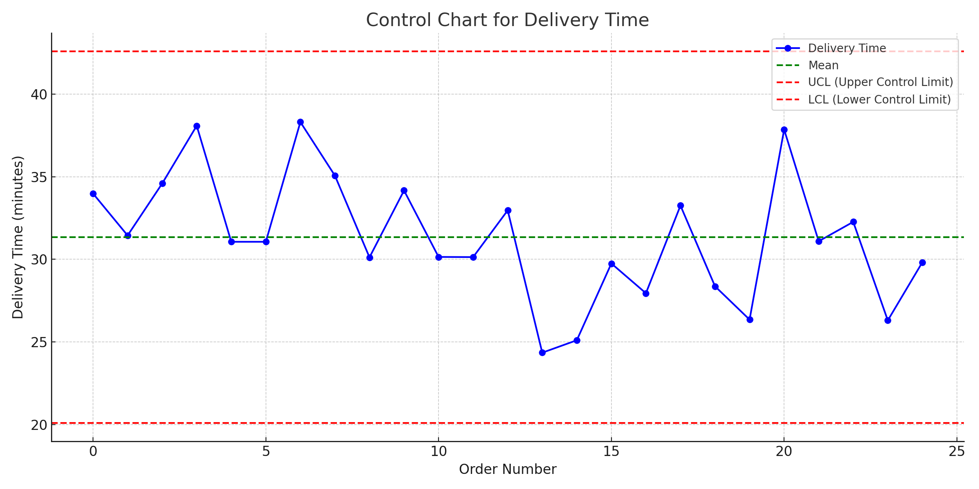
Control Chart for Delivery Time
D
M
A
I
C

Slide 27
DMAIC Roadmap
DEFINE
1 – Listen to the VoC
2 – Create Project Charter
3 – Map Current Process
MEASURE
4 – Investigate Measurement Systems
5 – Run Control Chart
6 – Run Capability Analysis
ANALYZE
7 – Identify Potential Causes
8 – Prioritize Potential Causes
9 – Validate Root Causes
IMPROVE
10 – Identify Potential Solutions
11 – Define and Execute the Action Plan
12 – Validate Process Improvement
CONTROL
13 – Define Control Plan
14 – Transfer to Process Owner
15 – Celebrate

Slide 28
Capability analysis for Quality
D
M
A
I
C
Capability analysis for quality assesses whether Alice’s restaurant consistently delivers pizzas that meet customer expectations in terms of taste, freshness, and presentation. With frequent complaints about quality, key metrics such as customer satisfaction ratings, defect rates (burnt, undercooked, or incorrect toppings), and consistency in preparation should be analyzed.
By collecting data on rejected orders, refund requests, and negative reviews, Alice can determine whether her restaurant’s process variability is within acceptable limits. If the process capability index (Cpk) is low, it indicates frequent deviations from quality standards. Factors such as inconsistent dough preparation, improper oven settings, or lack of standardized recipes could be contributing to quality issues. To improve, Alice can implement strict quality control measures, staff training, and standardized processes to ensure every pizza meets the expected standards before delivery.

Slide 29
Capability analysis for Delivery
D
M
A
I
C
Capability analysis evaluates whether Alice’s restaurant delivery process meets customer expectations regarding speed and quality. Given that customers are complaining about long delivery times and inconsistent food quality, it is essential to analyze process capability using key performance metrics such as average delivery time, standard deviation, and defect rates (late deliveries or incorrect orders).
By collecting historical delivery data, Alice can compare actual performance against customer expectations (e.g., delivering within 30 minutes). If the process has a high variation, it indicates inefficiencies such as slow order preparation, bottlenecks in packaging, or delays in the delivery network. A low process capability (Cp or Cpk) means that the current system is not consistently meeting the desired standards. To improve, Alice can optimize kitchen workflow, use route optimization software for delivery, or collaborate with third-party delivery services to ensure timely and high-quality deliveries.

Slide 30
ANALYZE
3
D
M
A
I
C

Slide 31
For many phenomena, 80% of consequences stem from
20% of the causes.
(Joseph M. Juran)

Slide 32
DMAIC Roadmap
DEFINE
1 – Listen to the VoC
2 – Create Project Charter
3 – Map Current Process
MEASURE
4 – Investigate Measurement Systems
5 – Run Control Chart
6 – Run Capability Analysis
ANALYZE
7 – Identify Potential Causes
8 – Prioritize Potential Causes
9 – Validate Root Causes
IMPROVE
10 – Identify Potential Solutions
11 – Define and Execute the Action Plan
12 – Validate Process Improvement
CONTROL
13 – Define Control Plan
14 – Transfer to Process Owner
15 – Celebrate

Slide 33
Identify wastes
D
M
A
I
C
Defects | Overproduction | Waiting | Non-utilized talent
Incorrect orders burnt pizzas missing toppings | Making pizzas before orders are placed leading to waste if not sold | Delays in preparing or dispatching orders | Staff skills not fully used (e.g., cooks doing delivery work instead of kitchen work)
Transport | Inventory | Motion | Extra-processing
Inefficient delivery routes causing delays | Overstocking ingredients that expire or understocking causing order delays | Staff walking back and forth due to poor kitchen layout | Repeated checking of orders due to lack of standardization

Slide 34
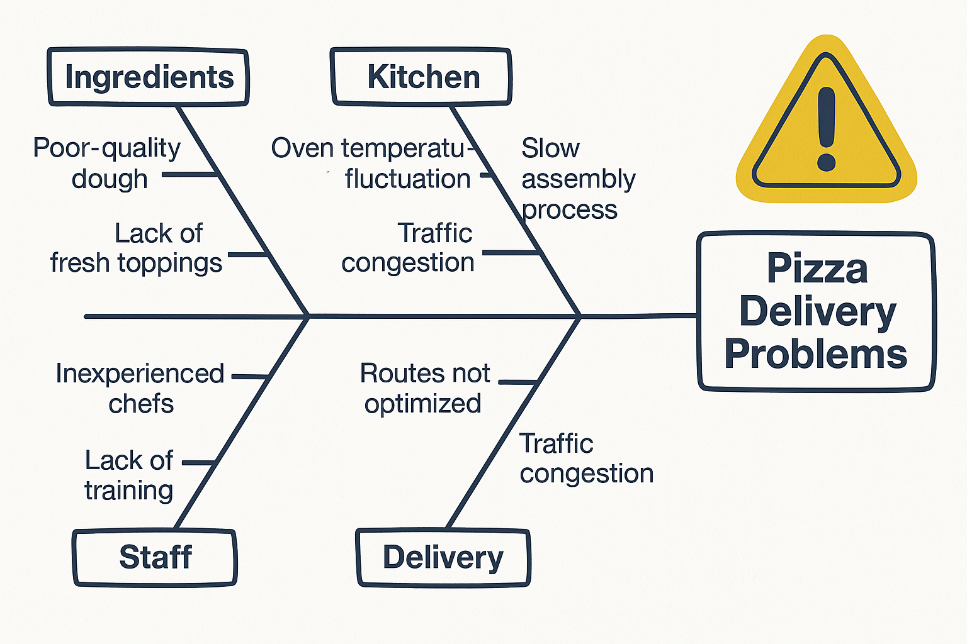
Ishikawa Diagram
D
M
A
I
C

Slide 35
DMAIC Roadmap
DEFINE
1 – Listen to the VoC
2 – Create Project Charter
3 – Map Current Process
MEASURE
4 – Investigate Measurement Systems
5 – Run Control Chart
6 – Run Capability Analysis
ANALYZE
7 – Identify Potential Causes
8 – Prioritize Potential Causes
9 – Validate Root Causes
IMPROVE
10 – Identify Potential Solutions
11 – Define and Execute the Action Plan
12 – Validate Process Improvement
CONTROL
13 – Define Control Plan
14 – Transfer to Process Owner
15 – Celebrate

Slide 36
Critical Potential Causes for Delivery
D
M
A
I
C
Several critical potential causes may be contributing to the delivery problems at Alice’s restaurant. One major cause is inefficient order management, where delays occur due to slow order processing or poor coordination between the kitchen and delivery staff. Another key factor is unoptimized delivery routes, which lead to longer travel times and late deliveries, especially during peak hours or in areas with heavy traffic.
Insufficient staffing can also be a bottleneck either not having enough delivery personnel or lacking trained staff who can handle orders swiftly and accurately. Additionally, equipment issues, such as unreliable vehicles or packaging that doesn't maintain food temperature, can affect both speed and food quality upon arrival. Lack of real-time tracking systems and poor communication between the restaurant and customers further amplify dissatisfaction.
Addressing these critical causes through process optimization, better logistics, and training will significantly improve Alice’s delivery performance and customer satisfaction.

Slide 37
Critical Potential Causes for Quality
D
M
A
I
C
The quality issues at Alice’s restaurant likely stem from several critical potential causes. One major factor is inconsistent ingredient quality, which can result from unreliable suppliers or improper storage practices that compromise freshness. Another significant issue is lack of standardized cooking procedures, where different chefs may follow varying methods, leading to inconsistent taste, texture, and presentation of the pizzas.
Inadequate staff training also plays a crucial role unskilled kitchen staff may mishandle ingredients or make errors in preparation, affecting the final product. Equipment malfunctions, such as uneven oven temperatures or faulty timers, can cause pizzas to be undercooked or burnt. Additionally, poor quality control checks before dispatching orders allow substandard food to reach customers, leading to dissatisfaction.
By addressing these critical causes through better training, strict quality standards, reliable suppliers, and consistent monitoring Alice can greatly enhance the overall food quality and regain customer trust.

Slide 38
DMAIC Roadmap
DEFINE
1 – Listen to the VoC
2 – Create Project Charter
3 – Map Current Process
MEASURE
4 – Investigate Measurement Systems
5 – Run Control Chart
6 – Run Capability Analysis
ANALYZE
7 – Identify Potential Causes
8 – Prioritize Potential Causes
9 – Validate Root Causes
IMPROVE
10 – Identify Potential Solutions
11 – Define and Execute the Action Plan
12 – Validate Process Improvement
CONTROL
13 – Define Control Plan
14 – Transfer to Process Owner
15 – Celebrate

Slide 39
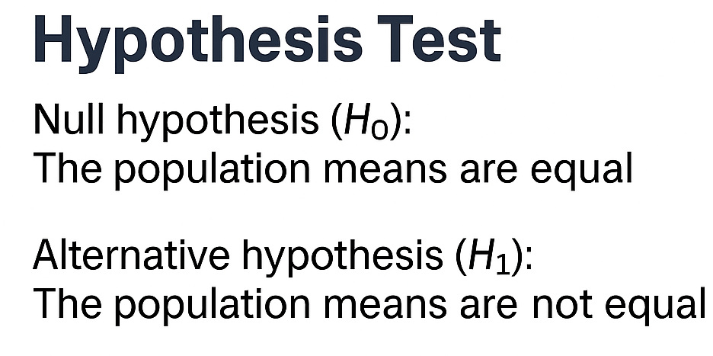
2 Sample t
D
M
A
I
C
3
3
2
4
3
3
2
3
4
2

Slide 40
2 Proportions
D
M
A
I
C
Category | Complaints | Total Orders | Proportion
Before Improvement | 25 | 100 | 0.25
After Improvement | 10 | 100 | 0.10

Slide 41
IMPROVE
4
D
M
A
I
C

Slide 42
Quality comes not from inspection,
but from improvement of the process.
(William Edwards Deming)

Slide 43
DMAIC Roadmap
DEFINE
1 – Listen to the VoC
2 – Create Project Charter
3 – Map Current Process
MEASURE
4 – Investigate Measurement Systems
5 – Run Control Chart
6 – Run Capability Analysis
ANALYZE
7 – Identify Potential Causes
8 – Prioritize Potential Causes
9 – Validate Root Causes
IMPROVE
10 – Identify Potential Solutions
11 – Define and Execute the Action Plan
12 – Validate Process Improvement
CONTROL
13 – Define Control Plan
14 – Transfer to Process Owner
15 – Celebrate

Slide 44
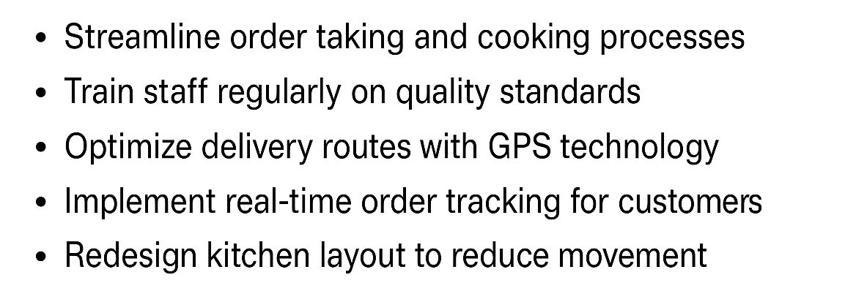
Potential Solutions
D
M
A
I
C

Slide 45
DMAIC Roadmap
DEFINE
1 – Listen to the VoC
2 – Create Project Charter
3 – Map Current Process
MEASURE
4 – Investigate Measurement Systems
5 – Run Control Chart
6 – Run Capability Analysis
ANALYZE
7 – Identify Potential Causes
8 – Prioritize Potential Causes
9 – Validate Root Causes
IMPROVE
10 – Identify Potential Solutions
11 – Define and Execute the Action Plan
12 – Validate Process Improvement
CONTROL
13 – Define Control Plan
14 – Transfer to Process Owner
15 – Celebrate

Slide 46
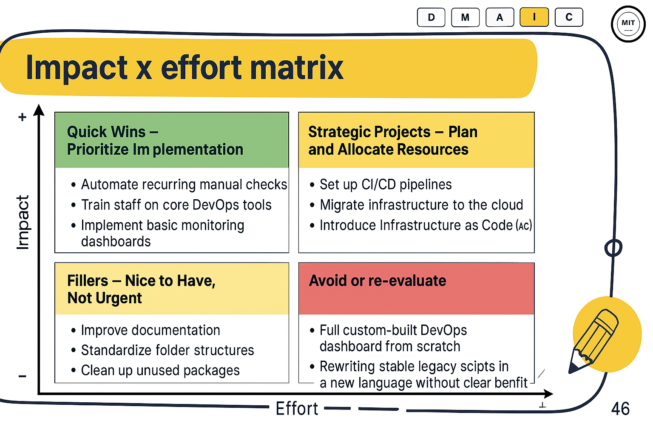
D
M
A
I
C
Impact x effort matrix
+
Impact
-
-
Effort
+

Slide 47
DMAIC Roadmap
DEFINE
1 – Listen to the VoC
2 – Create Project Charter
3 – Map Current Process
MEASURE
4 – Investigate Measurement Systems
5 – Run Control Chart
6 – Run Capability Analysis
ANALYZE
7 – Identify Potential Causes
8 – Prioritize Potential Causes
9 – Validate Root Causes
IMPROVE
10 – Identify Potential Solutions
11 – Define and Execute the Action Plan
12 – Validate Process Improvement
CONTROL
13 – Define Control Plan
14 – Transfer to Process Owner
15 – Celebrate

Slide 48
Before vs after for Quality
D
M
A
I
C
Day | Sample size | Defective units |  | Day | Sample size | Defective units |  | Day | Sample size | Defective units
1 | 147 | 0 |  | 11 | 145 | 1 |  | 21 | 107 | 1
2 | 124 | 1 |  | 12 | 134 | 1 |  | 22 | 117 | 0
3 | 135 | 0 |  | 13 | 102 | 0 |  | 23 | 144 | 1
4 | 148 | 1 |  | 14 | 138 | 0 |  | 24 | 119 | 0
5 | 119 | 0 |  | 15 | 128 | 0 |  | 25 | 133 | 0
6 | 105 | 1 |  | 16 | 114 | 1 |  | 26 | 139 | 0
7 | 138 | 0 |  | 17 | 104 | 0 |  | 27 | 149 | 0
8 | 131 | 1 |  | 18 | 134 | 0 |  | 28 | 128 | 0
9 | 133 | 0 |  | 19 | 127 | 0 |  | 29 | 106 | 1
10 | 119 | 1 |  | 20 | 125 | 0 |  | 30 | 137 | 0

Slide 49
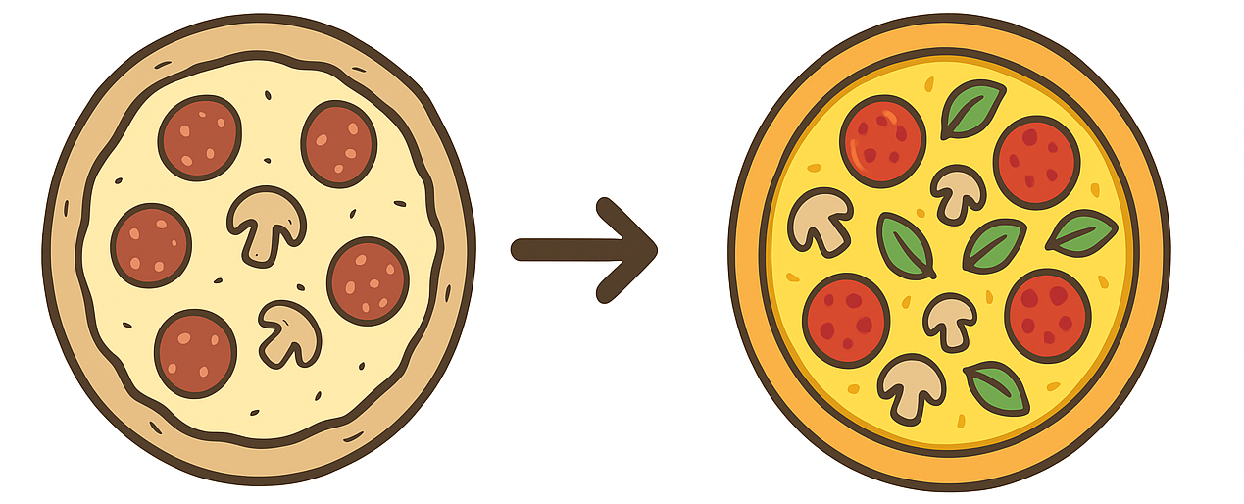
Before vs after for Quality
D
M
A
I
C
The implementation of the proposed solution led to a significant improvement in the quality of the process. Before the changes, quality metrics reflected inefficiencies such as delays, errors, or inconsistencies. Post-implementation, quality indicators show streamlined operations, reduced defects, and enhanced accuracy—ultimately leading to better customer satisfaction and operational excellence.

Slide 50
Before vs after for Delivery Time
D
M
A
I
C
2 |  | 3 |  | 2
2 |  | 3 |  | 4
3 |  | 4 |  | 4
3 |  | 3 |  | 3
3 |  | 3 |  | 4
4 |  | 3 |  | 4
4 |  | 3 |  | 3
3 |  | 2 |  | 3
3 |  | 3 |  | 3
4 |  | 2 |  | 3

Slide 51
Before vs after for Delivery Time
D
M
A
I
C
Before: Delivery times averaged 45 minutes, leading to frequent customer complaints about delays and cold food. The process suffered from poor kitchen coordination, lack of real-time tracking, and inefficient delivery routes.
After: With process improvements, delivery time reduced to 25 minutes. The restaurant implemented better kitchen workflow, order tracking, and route optimization, resulting in a 60% drop in complaints and improved customer satisfaction.

Slide 52
CONTROL
4
D
M
A
I
C

Slide 53
Progress cannot be generated when we are satisfied with existing situations.
(Taiichi Ohno)

Slide 54
DMAIC Roadmap
DEFINE
1 – Listen to the VoC
2 – Create Project Charter
3 – Map Current Process
MEASURE
4 – Investigate Measurement Systems
5 – Run Control Chart
6 – Run Capability Analysis
ANALYZE
7 – Identify Potential Causes
8 – Prioritize Potential Causes
9 – Validate Root Causes
IMPROVE
10 – Identify Potential Solutions
11 – Define and Execute the Action Plan
12 – Validate Process Improvement
CONTROL
13 – Define Control Plan
14 – Transfer to Process Owner
15 – Celebrate

Slide 55
Control Plan
D
M
A
I
C
CTQ | Critical X | Unit | Spec Limits | Reaction Plan
Quality | Number of incorrect orders | Defects/order | <0.05 | Investigate and rectify issue
Delivery Time | Time to deliver order | Minutes | <30 | Optimize the delivery process

Slide 56
DMAIC Roadmap
DEFINE
1 – Listen to the VoC
2 – Create Project Charter
3 – Map Current Process
MEASURE
4 – Investigate Measurement Systems
5 – Run Control Chart
6 – Run Capability Analysis
ANALYZE
7 – Identify Potential Causes
8 – Prioritize Potential Causes
9 – Validate Root Causes
IMPROVE
10 – Identify Potential Solutions
11 – Define and Execute the Action Plan
12 – Validate Process Improvement
CONTROL
13 – Define Control Plan
14 – Transfer to Process Owner
15 – Celebrate

Slide 57
Transfer to Process Owner
D
M
A
I
C
The improved delivery process has successfully reduced delivery time from X days to Y days.
Control measures have been implemented to sustain results.
Process Owner: is now responsible for monitoring CTQs Quality and Delivery Time.
KPIs are tracked via a dashboard updated weekly.
Any deviations will trigger the reaction plan.

Slide 58
DMAIC Roadmap
DEFINE
1 – Listen to the VoC
2 – Create Project Charter
3 – Map Current Process
MEASURE
4 – Investigate Measurement Systems
5 – Run Control Chart
6 – Run Capability Analysis
ANALYZE
7 – Identify Potential Causes
8 – Prioritize Potential Causes
9 – Validate Root Causes
IMPROVE
10 – Identify Potential Solutions
11 – Define and Execute the Action Plan
12 – Validate Process Improvement
CONTROL
13 – Define Control Plan
14 – Transfer to Process Owner
15 – Celebrate

Slide 59
Customer satisfaction!!!
Celebrate!
Recognize!

Slide 60

Slides provided by Slides Carnival
Free templates for all your presentation needs
For PowerPoint and Google Slides
100% free for personal or commercial use
Ready to use, professional and customizable
Blow your audience away with attractive visuals

